Slide 1
Using existing CCTV network for crowd management, crime prevention, and work monitoring using AIML
CSE7301 University Project
Review-4
Batch Number: PSC235
Under the Supervision of,
Dr./Mr./Ms./Prof. Mrs.Rama Bai V
Professor / Associate Professor / Assistant Professor
School of Computer Science and Engineering
Presidency University
Roll Number | Student Name
20211CSE0017 | D.Riyaz
20211CSE0057 | M.Kiran Kumar
20211CSE0029 | D.Sai Jaswanth
20211CSE0060 | S.Sapthagiri
Name of the Program: B.Tech
Name of the HoD: Dr.Asif Md
Name of the School Project Coordinators: Dr. Sampath A K / Dr. Abdul Khadar A / Mr. Md Ziaur Rahman

Slide 2
Introduction
The project focuses on revolutionizing current surveillance systems by integrating advanced Artificial Intelligence (AI) and Machine Learning (ML) technologies into existing CCTV networks to enhance crowd management, crime prevention, and work monitoring. This initiative employs the YOLOv5 algorithm, the latest in a series of innovations in object detection technology, specifically optimized to recognize and analyze human figures and movements within crowded scenes and workplace environments.
The traditional approach to surveillance, which often involves continuous manual monitoring by human operators, is fraught with challenges including high labor costs, fatigue-related errors, and delayed responses to emergent situations. By contrast, our AI-powered system is designed to automate the detection process, accurately counting and analyzing individuals in real-time video feeds, thus enabling proactive management of crowd sizes and movements.
With the objective of improving public safety and operational efficiency, the project also aims to provide a proactive tool that alerts authorities to potential threats or unsafe conditions as they develop. This capability ensures that responses can be as immediate and effective as possible. The AI system enhances situational awareness, reduces the reliance on human monitoring, and uses data-driven insights to optimize resource allocation and security measures.

Slide 3
Literature Review
S.NO | YEAR | AUTHORS | TITLE | OUT COMES
1 | 2016 | Redmon et al. | You Only Look Once: Unified, Real-Time Object Detection | YOLO marks a pivotal development in object detection technologies. By unifying the detection process into a single neural network, YOLO simplifies and accelerates object detection, allowing for real-time performance which is crucial for applications requiring immediate analytical feedback, such as video surveillance and autonomous driving.
2 | 2020 | Bochkovskiy et al. | YOLOv4: Optimal Speed and Accuracy of Object Detection | YOLOv4 represents an evolution in the YOLO series by optimizing previous models for better performance with practical implementations in mind. The enhancements in detection speed and accuracy, alongside its feasibility on standard hardware, make YOLOv4 a robust tool for real-time object detection across various applications, including public safety and surveillance systems.

Slide 4
Existing method
The existing method for managing crowds, preventing crime, and monitoring workspaces predominantly relies on manual observation and monitoring of CCTV footage by security personnel. This traditional approach requires constant human vigilance, which can be labor-intensive and prone to human error due to fatigue and the limitations of continuous focus. Typically, these systems do not possess the capability to analyze video content in real-time; instead, they record footage that is retrospectively reviewed in response to specific incidents. This reactive nature means that potential threats or emergencies are often only addressed after they have already escalated, leading to delayed responses and less effective management of situations. Furthermore, the existing infrastructure does not incorporate advanced data analytics, which limits its ability to identify subtle patterns or predict potential problems based on crowd behavior. As a result, the current systems are not only resource-intensive but also less efficient in enhancing public safety and operational productivity.

Slide 5
Disadvantages
1. Limited Real-time Analysis: Traditional CCTV systems primarily record footage for later review rather than analyze data in real-time. This delay in data processing prevents timely intervention during critical moments when immediate action is required to prevent potential incidents or manage emergencies.
2. High Dependency on Human Monitoring: The need for continuous human monitoring leads to significant labor costs and dependency on the alertness and attentiveness of personnel. Human operators are susceptible to fatigue and distraction, which can reduce the accuracy and efficiency of surveillance.
3. Scalability Issues: Manual monitoring becomes increasingly impractical as the number of cameras and the size of monitored areas grow. Expanding surveillance coverage without corresponding increases in personnel is challenging, making comprehensive monitoring difficult to achieve.
4. Delayed Response Times: Since existing systems often lack automated alert features, there can be significant delays between the occurrence of an incident and its detection by human monitors. These delays can result in inadequate responses to fast-developing situations.

Slide 6
Proposed Method
The proposed system seeks to significantly enhance the capabilities of existing CCTV networks through the integration of advanced Artificial Intelligence (AI) and Machine Learning (ML) technologies, particularly utilizing the state-of-the-art YOLOv5 algorithm for real-time video analysis. This innovative system is designed to autonomously detect, track, and analyze individuals and crowd dynamics directly from video feeds, enabling proactive surveillance and immediate response to potential security threats or emergencies.
Key features of the proposed system include automated crowd counting and behavior analysis, which trigger alerts when unusual patterns or excessive crowd densities are detected. This allows for swift action to manage potential risks effectively. Moreover, the system's capability to process and analyze data in real-time reduces the dependency on human monitoring, thereby minimizing human error and enhancing the overall efficiency of the surveillance process.

Slide 7
Objectives
The primary objective of this project is to enhance public safety, crime prevention, and operational efficiency by integrating advanced Artificial Intelligence (AI) and Machine Learning (ML) algorithms into existing CCTV networks. Utilizing the YOLOv5 algorithm, the system aims to autonomously monitor and analyze real-time video feeds to efficiently manage crowds, detect potential security threats, and monitor workplace activities. This proactive surveillance solution is designed to automatically identify unusual crowd patterns and activities, significantly reducing the need for manual monitoring while increasing the responsiveness to emergent situations. By transforming passive CCTV footage into a dynamic tool for security management, the project seeks to provide a cost-effective, scalable, and technologically advanced method to bolster safety and productivity in various environments, ranging from public spaces to workplace settings.

Slide 8
Modules
1. System:
1.1 Preprocessing:
Once the image data is loaded, it becomes essential to undergo data cleaning and preprocessing procedures. This involves tasks like handling potential image artifacts, addressing missing or corrupted images, encoding categorical labels if applicable, and normalizing pixel values. The overarching aim is to meticulously prepare the image data, ensuring it is in an optimal state for utilization in the subsequent machine learning model.
1.2 Data Splitting:
Once your data is preprocessed, you typically split it into training and testing sets. The training set is used to train the model, and the testing set is used to evaluate its performance. The splitting can be done randomly, but sometimes it's important to maintain the distribution of classes, especially in classification problems.
1.3 Model Training:
With the data split, you can now train your machine learning model. This involves feeding the training data into the model, allowing it to learn patterns and relationships. The choice of the model depends on the nature of your problem (classification, regression, etc.) and the characteristics of your data. Training may involve tuning hyperparameters to optimize the model's performance.

Slide 9
Modules
1.4 Generating Results:
Use the trained model to generate predictions on new, unseen data by calling the predict method. 2. User:
2.1 Data Loading:
In this step, you bring your raw data into your program. This could involve reading data from various extensions of images such as JPG, PNG, etc.
2.2 Choosing Algorithms:
Algorithm choice depends on the problem and data.
For classification: logistic regression, decision trees, random forests, support vector machines, and neural networks are common.
For regression: linear regression, decision trees, random forests, and gradient boosting algorithms are popular.
Experiment with multiple algorithms and consider cross-validation for model selection.
2.3 Viewing Results:
After model training, evaluate performance-using metrics like accuracy, precision, recall, and confusion matrix for classification tasks. Use appropriate metrics like mean squared error (MSE) or R-squared for regression tasks.

Slide 10
software components
SOFTWARE REQUIREMENS
Technology : Python 3.6+
Server Deployment : Xampp Server
Database : MySQL

Slide 11
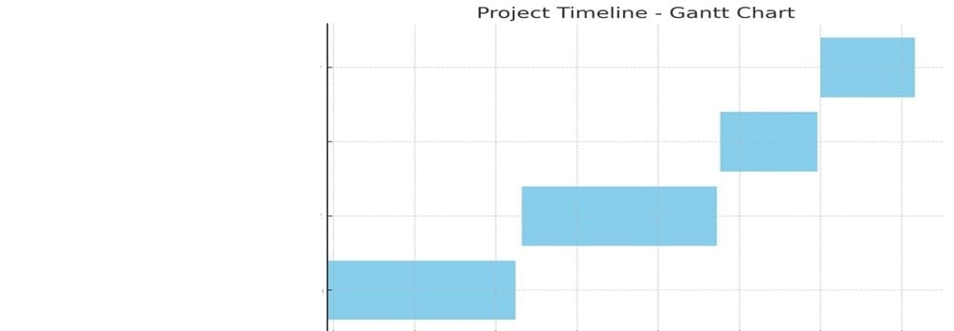
Timeline of Project

Slide 12
Conclusion
This project revolutionizes surveillance by integrating AI and ML with existing CCTV networks to enhance crowd management, crime prevention, and work monitoring. Utilizing YOLOv5 for real-time video analysis, it enables automated detection, proactive security measures, and efficient resource allocation. By reducing reliance on manual monitoring and improving response times to potential threats, the system ensures heightened security and workplace productivity. Its compatibility with existing infrastructure makes it a cost-effective and scalable solution for various environments. This innovation marks a significant step toward smarter, AI-driven surveillance, offering enhanced safety and operational efficiency across public and private spaces.

Slide 13
References
[1] Redmon, J., Divvala, S., Girshick, R., & Farhadi, A. (2016). You Only Look Once: Unified, Real-Time Object Detection. Proceedings of the IEEE conference on computer vision and pattern recognition.
[2] Bochkovskiy, A., Wang, C.-Y., & Liao, H.-Y. M. (2020). YOLOv4: Optimal Speed and Accuracy of Object Detection. arXiv:2004.10934.
[3] Lin, T.-Y., Goyal, P., Girshick, R., He, K., & Dollár, P. (2017). Focal Loss for Dense Object Detection. IEEE Transactions on Pattern Analysis and Machine Intelligence.
[4] Ren, S., He, K., Girshick, R., & Sun, J. (2015). Faster R-CNN: Towards Real-Time Object Detection with Region Proposal Networks. IEEE Transactions on Pattern Analysis and Machine Intelligence.
[5] Howard, A., Sandler, M., Chen, B., Wang, W., Chen, L.-C., Tan, M., Chu, G., Vasudevan, V., Zhu, Y., Pang, R., & Adam, H. (2019). Searching for MobileNetV3. Proceedings of the IEEE International Conference on Computer Vision.
[6] Liu, W., Anguelov, D., Erhan, D., Szegedy, C., Reed, S., Fu, C.-Y., & Berg, A. C. (2016). SSD: Single Shot MultiBox Detector. European conference on computer vision.

Slide 14
Thank You

